Slide 1
Cybersecurity Incident Response Systems using Reinforcement Learning
Rogelio Velázquez
Associate Professorship of Embedded Systems and Internet of Things
Technical University of Munich
Munich, 26.07.23
1

Slide 2

Roadmap
Summary of IRS and proposals reviewed
Analysis of key aspects of several approaches of RL-based IRS
Model inputs
Basic architecture
Algorithms used for decision making
Responses
Performance
Conclusions

Slide 3

Summary of IRS
IRS: Security countermeasure that is triggered when an intrusion is detected
Main goal of IRS: Take actions to mitigate the effect of an attack after it happens
RL facilitates the autonomous decision making for selecting a proper response
3 proposals were reviewed in detail:
[1] DRL based smart mitigation of DDoS flooding in SDN
[2] “DeepAir” DRL for adaptive IR in SDN
[3] “IDERES” Intrusion detection and RS using ML and attack graphs
.
Notes:
In simpler terms, a neural network can be seen as a mathematical function that takes an input, passes it through multiple layers of interconnected nodes (neurons), and produces an output.

Slide 4
Model Inputs
RL models need inputs for the decision-making process.
Traffic information is collected so that the RL can use it to take actions
In [1] they collect data using the standard protocol OpenFlow
In [2] they use the Hping3 tool for DoS attack traffic generation
In [3] they create a training dataset from both normal and malicious traffic (IEEE datasets)
.
Key concept: Collect attack data (traffic information) to “feed” the model
Notes:
In simpler terms, a neural network can be seen as a mathematical function that takes an input, passes it through multiple layers of interconnected nodes (neurons), and produces an output.

Slide 5
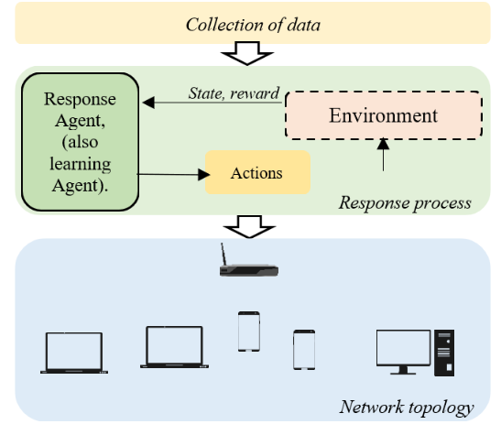
Basic Architecture
Gather information to feed the model with inputs as network traffic or datasets for training it
Then the Agent responds with an action depending on the state that was set
These actions need to lead to a mitigation effect on the environment (the response)
The response is provided by an entity. Different names:
In [1] the learning agent is called as a “defender router”.
In [2] a “control agent”
In [3] a “mitigation engine”
Figure 1. General architecture of the process of an IRS that uses RL to respond to an attack.
Notes:
The architectures of the reviewed models link the information collection module and the mitigation module to have an effect on the targeted system.

Slide 6
Algorithms used for decision-making
Determine the most optimal actions to take regarding different states of the environment.
Improves the decision-making process over time based on learned knowledge
[1]: An actor-critic-based DDPG (Deep Deterministic Policy Gradient)
Defines the current policy
Maps states to specific action deterministically
[2] Use of 2 algorithms
Q learning algorithm to obtain the optimal policy
Double Q-learning algorithm: For quickly obtaining the optimal policy while defending against attack traffic flows
.

Slide 7
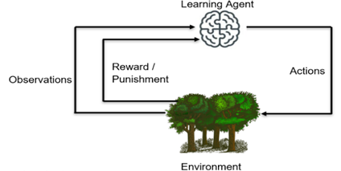
Algorithms used for decision-making
[3]: Discrete-time partially observable Markov decision process (POMDP)
Based on game theory involving 2 players: attacker and defender
In each method, the algorithm’s policy purpose is to describe how an agent behaves
“Obtaining the policy” refers to the process of learning and generating an optimal policy to achieve a given goal.
How? By updating the policy based on the obtained rewards and improving its decision-making accuracy.
.
Figure 2. The basic components of an RL model

Slide 8
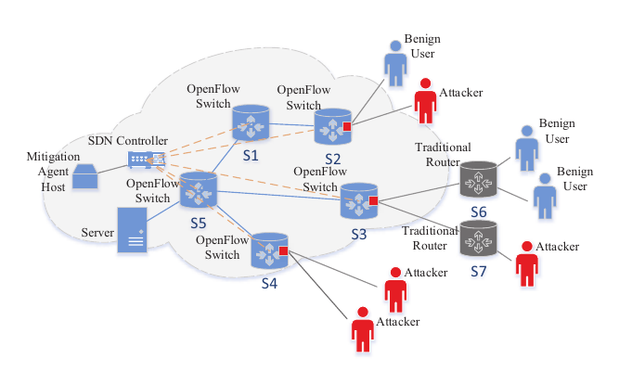
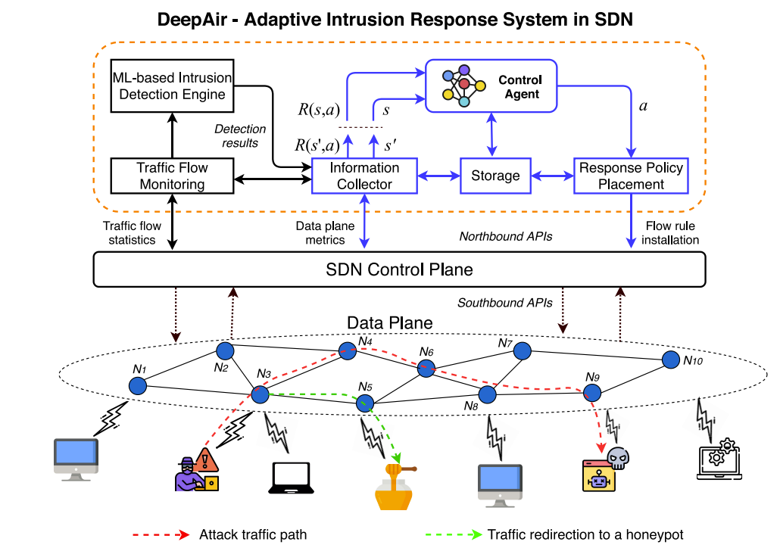
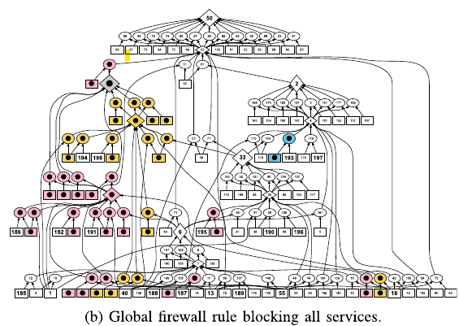
Responses
Active: Change the system’s state to block a detected attack and mitigate the effects that this could have
Passive: Only raise alerts and notify operators
[1]: Defender router applies throttling of the traffic through OpenFlow meters.
[2]: They tackle malicious traffic flows while minimizing the impact on the forwarding of legitimate traffic flows
[3]: The defender responds to an attack with defensive actions: It deploys IPtables firewall rules to block exploit nodes in the attack graph.
.
Figure 3. Attack scenario at [1]
Source: Liu, et.al. 2018
Figure 4. Attack scenario at [2].
Source: Phan, et. al.
Figure 5. Attack scenario at [3]
Source: Rose, et.al. 2022
Notes:
[1] They defined that if the aggregate traffic rate exceeds the maximum bandwidth, excess traffic will be dropped, and that benign traffic should not be dropped to not let attackers reach their goals
[3] A different response is proposed in [11], where they use a game theory, defining an attacker, and a defender. Here the defender keeps a belief about the network state and the attacker's strategy based on information from the attack graph, network event alerts and previous mitigation actions

Slide 9
Performance
[1]: Measure the percentage of benign traffic and block of the malicious traffic.
DRL is compared against Additive Increase Multiplicative Increase (AIMD) and a Coordinated Team Learning approach.
5 different attack patterns were set. Each attack pattern is conducted for 100 episodes.
[2]: “DeepAir” outperforms the other 3 approaches. The ratio of dropped malicious packets is measured (since an attack is detected)
“DeepAir” prevents 85% of the attack packets from arriving to the victim.
Q-learning prevents 60% . GATE and GTAC-IRS prevent 30% and 45% respectively
[3] Thirteen different cyber-attacks scenarios were set
Setting a Firewall rule type (either Specific or global)
Measure whether the attack is mitigated or not
.
Notes:
[1] The mitigation agent didn’t learn these patterns
[2]

Slide 10
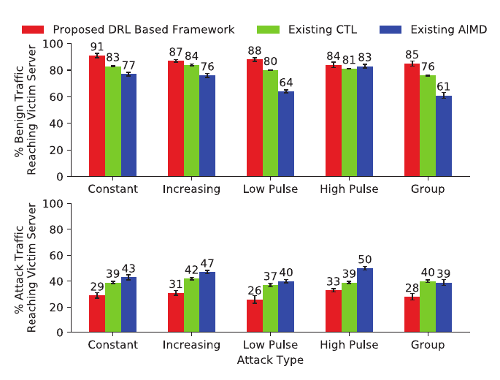
Performance
.
Tested cyber-attack scenarios | Attack mitigated
Zero-day exploit | Yes ( 3/16)
DDoS attack with Mirai Botnet | Yes ( 12/16)
DDoS attack with Black Energy | Yes ( 12/16)
Zeus malware | Yes ( 12/16)
Java-RMI backdoor | Yes ( 10/16)
distcc_exec backdoor | Yes ( 12/16)
UnrealIRCD backdoor | Yes ( 10/16)
Web Tomcat exploit | Yes ( 10/16)
Ruby DRb code execution | Yes ( 11/16)
Hydra FTP bruteforce | Yes ( 12/16)
Hydra SSH bruteforce | Yes ( 12/16)
SMTP User Enumeration | Yes ( 7/16)
NetBIOS-SSN | Yes ( 12/16)
Figure 6. Performance of DRL agents for “unseen” attack types for [1]
Source: Liu, et.al. 2018
Table 1. Mitigation outcomes at [3]
Source: Rose, et.al. 2022
Notes:
[1] The mitigation agent didn’t learn these patterns
[3] the table at [3], the “16” are the number of executions

Slide 11
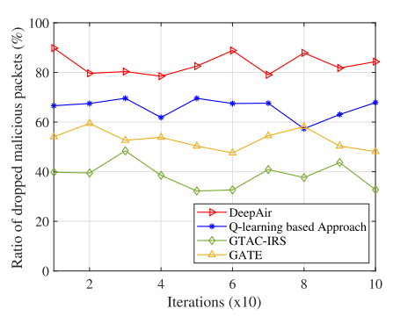
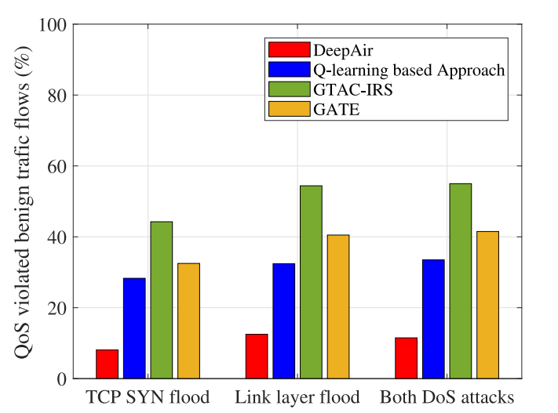
Performance
.
Figure 8. Performance of [2] against both DoS attack types
Figure 9. Performance of [2] Ratio of violated benign traffic flows
Notes:
[1] The mitigation agent didn’t learn these patterns
[2]

Slide 12


Conclusions
Several considerations to take: Type of responses that the model needs to have, the environment with whom it interacts, the network assumptions taken for the model, how is trained, and other factors to contemplate.
External factors such as environment limitations and how the IRS can be integrated into the system should be also considered
The accuracy of the data used for training and decision-making can significantly impact the performance and effectiveness of the system.
Nevertheless, vulnerabilities still exist:
Unknown attacks and exploitation of RL algorithms
Overlifting: The distribution of data in real world-scenarios differs from the training data.
.
Notes:
[1] The mitigation agent didn’t learn these patterns
[2]

Slide 13
References:
[1] Y. Liu, M. Dong, X. Jia, J. Li and Wu, J. (2018). “Deep Reinforcement Learning based Smart Mitigation of DDoS Flooding in Software-Defined Networks” in IEEE 23rd International Workshop on Computer Aided Modeling and Design of Communication Links and Networks (CAMAD) IEEE, 2018. [Online]. Available: https://doi.org/10.1109/camad.2018.8514971
[2] T. Q. Phan and T. Bauschert. (2022). “DeepAir: Deep Reinforcement Learning for Adaptive Intrusion Response in Software-Defined Networks” in IEEE Transactions on Network and Service Management Transactions on Network and Service Management, vol. 19 no. 13. IEEE. September. 2022. [Online]. Available: https://doi.org/10.1109/tnsm.2022.3158468
[3] J. R. Rose, M. Swann, K. P. Grammatikakis, I. Koufos, G. Bendiab, S. Shiaeles and N. Kolokotronis, “IDERES: Intrusion detection and response system using machine learning and attack graphs” in Journal of Systems Architecture. Elsevier Ltd. 2022. [Online]. Available: https://doi.org/10.1016/j.sysarc.2022.102722

